Slide 1
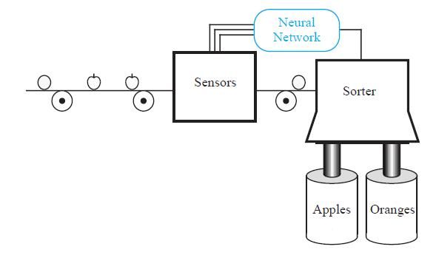
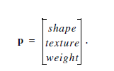


Neural Networks

Slide 2
Supervised and unsupervised learning
Hebbian
Perceptron
Deep Learning
Neural Networks
Backpropagation
Hamming Network
SOM
Hopfield Network

Slide 3
Definitions
Neural Networks
are networks of neurons, for example, as found in real (i.e. biological) brains •
Artificial Neural Networks(ANNs)
are networks of Artificial Neurons and hence constitute crude approximations to parts of real brains. They maybe physical devices, or simulated on conventional computers.

Slide 4
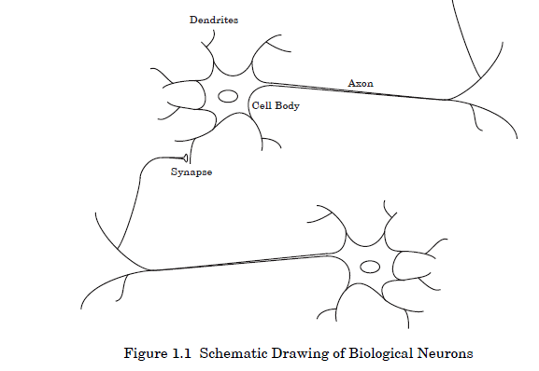
The brain consists of a large number of highly connected elements (approximately 104 connections per element) called neurons. Neurons have three principal components: the dendrites, the cell body and the axon. Some of the neural structure is defined at birth. Other parts are developed through learning, as new connections are made and others waste away.

Slide 5
The dendrites are tree-like receptive networks of nerve fibers that carry electrical signals into the cell body.
The cell body effectively sums and thresholds these incoming signals.
The axon is a single long fiber that carries the signal from the cell body out to other neurons.
The point of contact between an axon of one cell and a dendrite of another cell is called a synapse.

Slide 6
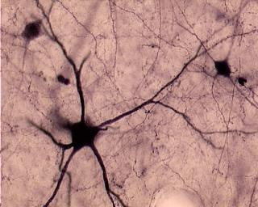
Biological Background
Neuron consists of:
Cell body
Dendrites
Axon
Synapses

Slide 7
What are Neural Networks used for?
There are two basic goals for neural network research:
Brain modeling: The biological goal of constructing models of how real brains work. This can potentially help us understand the nature of perception, actions, learning and memory, thought and intelligence and/or formulate medical solutions to brain damaged patients
Artificial System Construction: engineering goal of building efficient systems for real world applications. This may make machines more powerful and intelligent, and may even improve upon human performance.

Slide 8
Neural Network Applications
Brain modelling
Aid our understanding of how the brain works, how behavior emerges from the interaction of networks of neurons, what needs to “get fixed” in brain damaged patients
Real world applications
Computer games –intelligent agents, chess, backgammon Robotics –autonomous adaptable robots Pattern recognition –speech recognition, seismic activity, sonar signals Data analysis –data compression, data mining Bioinformatics –DNA sequencing, alignment

Slide 9
There are three broad types of learning
Supervised learning (i.e. learning with an external teacher)
Unsupervised learning (i.e. learning with no help)
Reinforcement learning (i.e. learning with limited feedback)

Slide 10
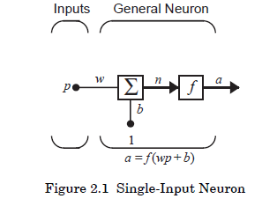
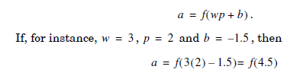
Neuron Model
Single-Input Neuron
The neuron output is calculated as

Slide 11
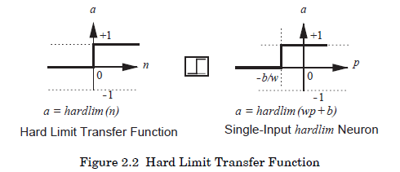
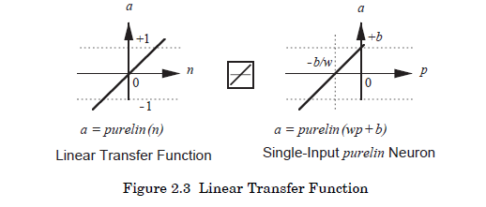
Transfer Functions
The transfer function may be a linear or a nonlinear function
the role of the transfer function in affecting the neural network performance is re-investigated.

Slide 12
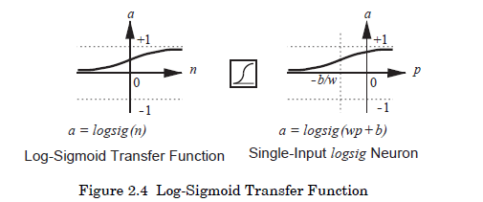

Slide 13
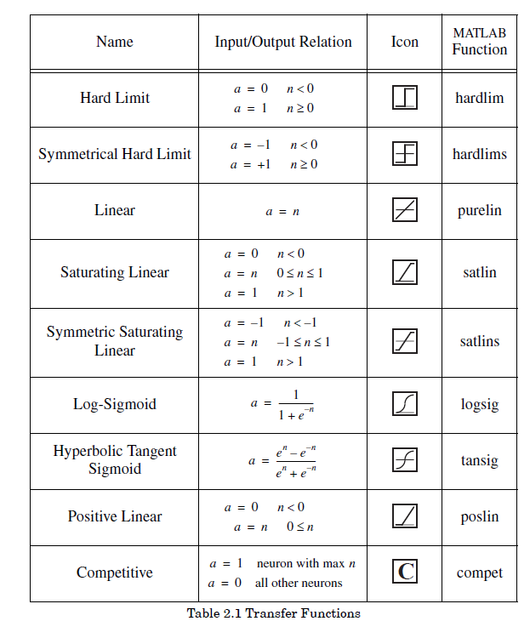

Slide 14
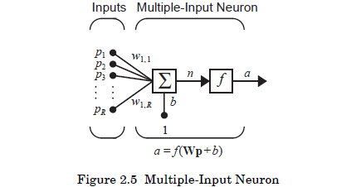
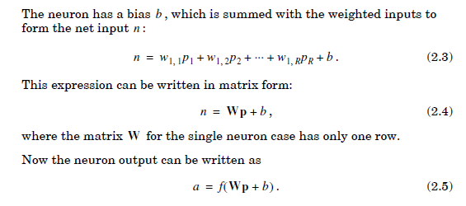
2.Multiple-Input Neuron

Slide 15
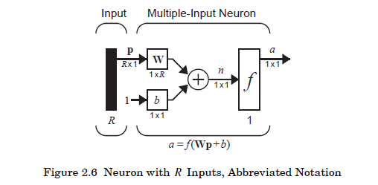
Abbreviation notation

Slide 16
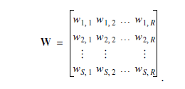
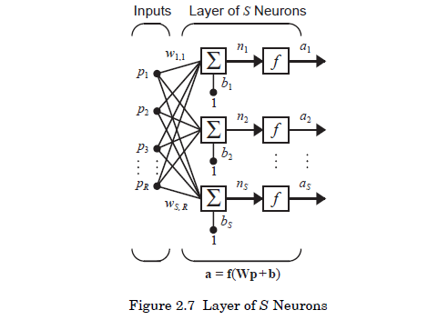
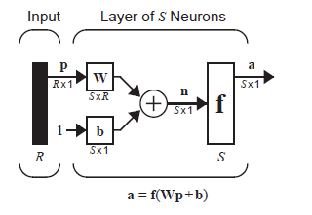
Network Architectures
A Layer of Neurons
The layer includes the weight matrix, the summers, the bias vector , the transfer function boxes and the output vector Each element of the input vector is connected to each neuron through the weight matrix . Each neuron has a bias, a transfer function and an output . Taken together, the outputs form the output vector

Slide 17
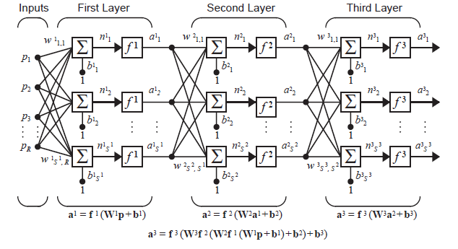
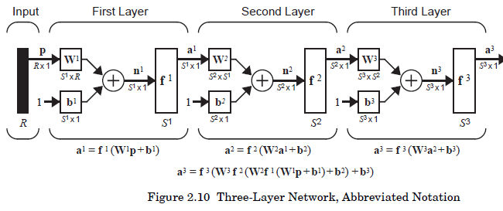
Multiple Layers of Neurons

Slide 18
P2.1 The input to a single-input neuron is 2.0, its weight is 2.3 and its bias is -3.
i. What is the net input to the transfer function?
ii. What is the neuron output?
i. The net input is given by:
ii. The output cannot be determined because the transfer function is not specified.

Slide 19

P2.2 What is the output of the neuron of P2.1 if it has the following transfer functions?
i. Hard limit
ii. Linear
iii. Log-sigmoid
i. For the hard limit transfer function:
ii. For the linear transfer function:
iii. For the log-sigmoid transfer function

Slide 20
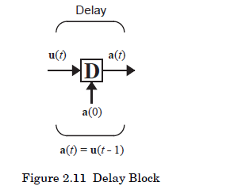

Recurrent Networks

Slide 21
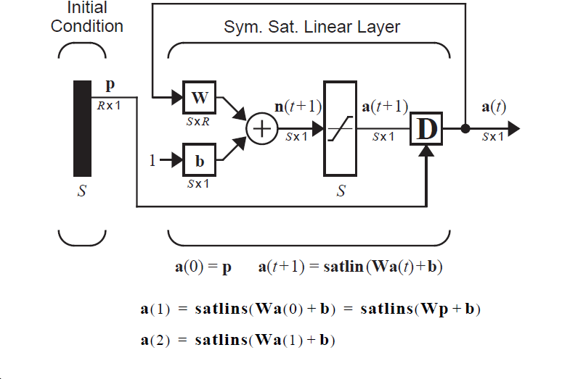
Recurrent Network

Slide 22
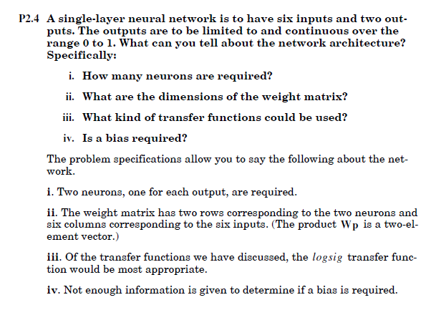

Slide 23
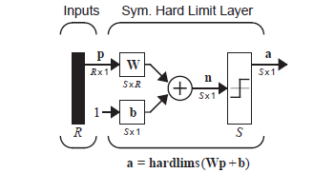
Perceptron
Single layer Perceptron
Feedforward Network
Linear Decision Boundary
One Neuron for each decision

Slide 24
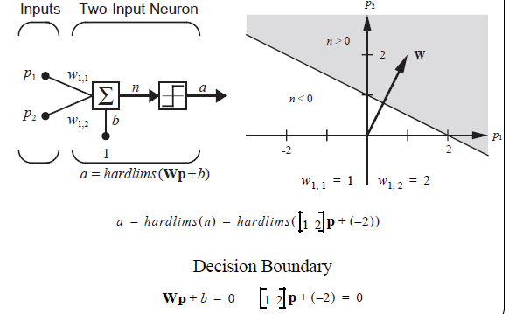
Two- Input Case

Slide 25
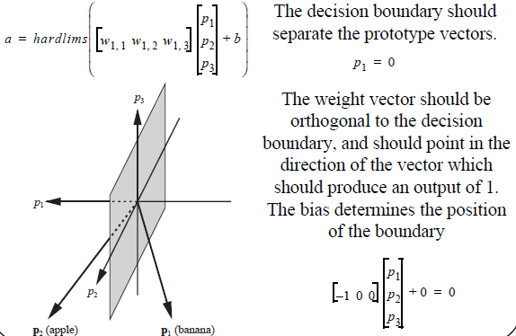
Apple /Banana Example

Slide 26
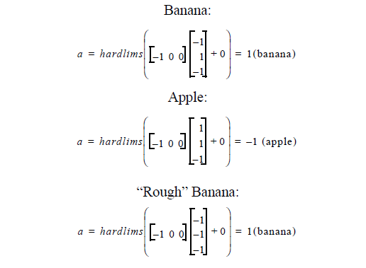
Testing Network

Slide 27
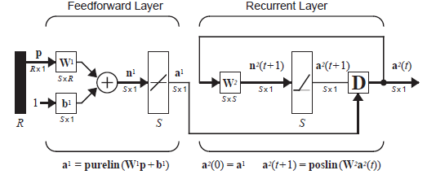
Hamming Network

Slide 28
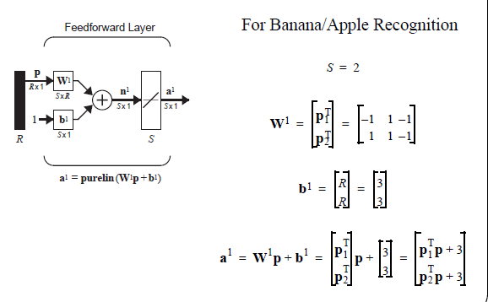
Feedforward Layer

Slide 29
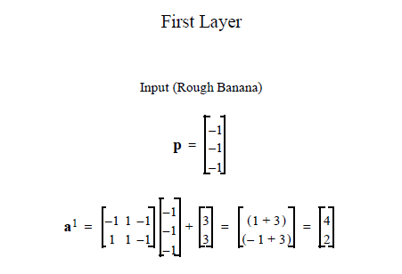

Slide 30
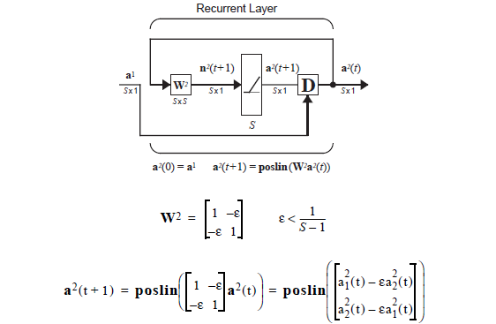
Recurrent Layer

Slide 31
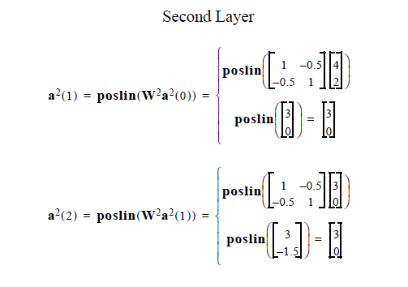

Slide 32
